Slide 2
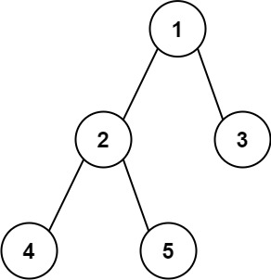
maxDiameter=Max(2,2+1)=3
Diam | Height Left | Height Right
2 | 2 | 1
Max(right,left)
RETRUN 1+Diam
Return Max(right,left)+1
RETRUN 1+Diam
Return Max(right,left)+1
Diam | Height Left | Height Right
1 | 1 | 1
Diam | Height Left | Height Right
0 | 0 | 0
Max(right,left)
maxDiameter=Max(0,1+1)=2
maxDiameter=Max(0,0+0)=0
NULL
Height=0
NULL
Height=0
RETRUN 1+Diam
Return Max(right,left)+1
RETRUN 1+Diam
Return Max(right,left)+1
maxDiameter=Max(0,0+0)=0
Diam | Height Left | Height Right
0 | 0 | 0
Diam | Height Left | Height Right
0 | 0 | 0
Max(right,left)
maxDiameter=Max(0,0+0)=0
NULL
Height=0
NULL
Height=0
NULL
Height=0
NULL
Height=0
maxDiameter = max(*maxDiameter, leftHeight + rightHeight);

Slide 3
maxDiameter=Max(2,3+1)=4
Diam | Height Left | Height Right
3 | 3 | 1
maxDiameter = max(*maxDiameter, leftHeight + rightHeight);
Max(right,left)
RETRUN 1+Diam
Return Max(right,left)+1
RETRUN 1+Diam
Return Max(right,left)+1
Diam | Height Left | Height Right
2 | 1 | 2
Diam | Height Left | Height Right
0 | 0 | 0
Max(right,left)
maxDiameter=Max(0,1+1)=2
maxDiameter=Max(0,0+0)=0
NULL
Height=0
NULL
Height=0
RETRUN 1+Diam
Return Max(right,left)+1
RETRUN 1+Diam
Return Max(right,left)+1
maxDiameter=Max(0,0+0)=0
Diam | Height Left | Height Right
0 | 0 | 0
Diam | Height Left | Height Right
1 | 1 | 0
Max(right,left)
maxDiameter=Max(0,1+0)=1
NULL
Height=0
NULL
Height=0
RETRUN 1+Diam
NULL
Height=0
6
Return Max(right,left)+1
maxDiameter=Max(0,0+0)=0
Diam | Height Left | Height Right
0 | 0 | 0
NULL
Height=0
NULL
Height=0

Slide 5
Level=1; nodes=4
Path = (3-1) + (2-1) = 3
Level=2; nodes=2
Level=2; nodes=0
Path = (3-2) + (3-2) = 2
Level=3 ; nodes=0
Level=3; nodes=0

